Slide 1
SNAKES AND LADDERS GAME PROJECT
CSCI-610 – Theoretical Concepts in Computers and Computation
Dr. Maherukh Akhtar
SHASHI KUMAR K (1338369)
VARUN GOLUKONDA (1319479)
KETHANA KATEPALLI (1321620)

Slide 2
Introduction
This presentation explores the Snakes and Ladders game from a theoretical perspective, discussing its formal game play, design considerations, analysis, and relevance to theory of computation.
Theory of computation is a branch of computer science that deals with the study of algorithms and computing capabilities and the inherent limitations of machines.
The Theory of computation can be a great integration to computer game theory.

Slide 3
Game Background:
Maximum of four players can play the game and minimum are two.
Each player is given a chance to roll the dice in a cyclic order, where the dice consists of values ranging from one to six.
Each Player enters the game when he rolls gets a one on the dice.
The board consists of 7 snakes and 5 ladders across the board, which are obstacles that players need to cross over to win the game.
First player to reach the 100th cell is considered as the winner and game continues until only one player is left behind.

Slide 4
Transition Inputs:
The below are the transition inputs for the snakes and ladders game:
Σplayers = {p1, p2, p3, p4}
Σdice = {1, 2, 3, 4, 5, 6}
Σblocks = {1, 2, 3, 4, 5 …… 95, 96, 97, 98, 100}
Σobstacles = {Snake, Stair}

Slide 5
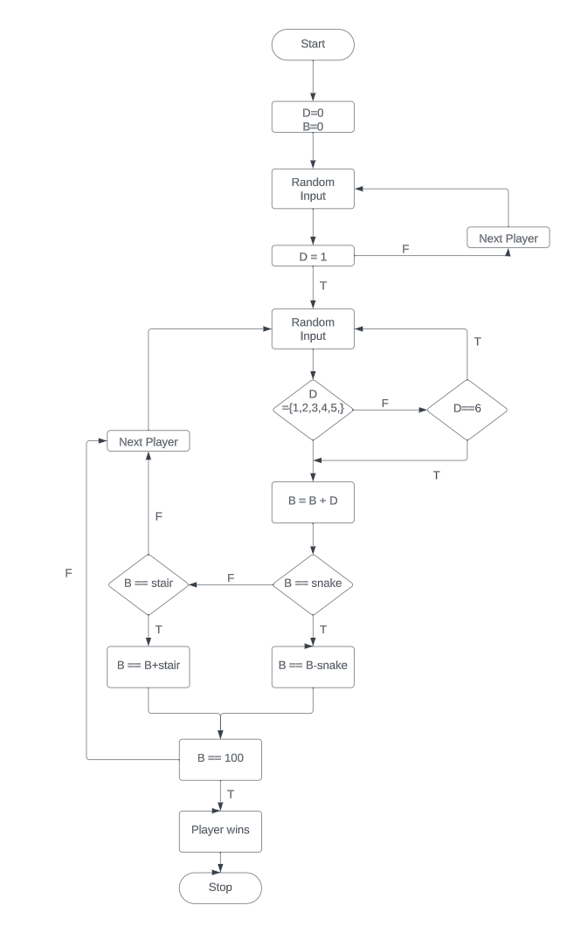
State Diagram:

Slide 6
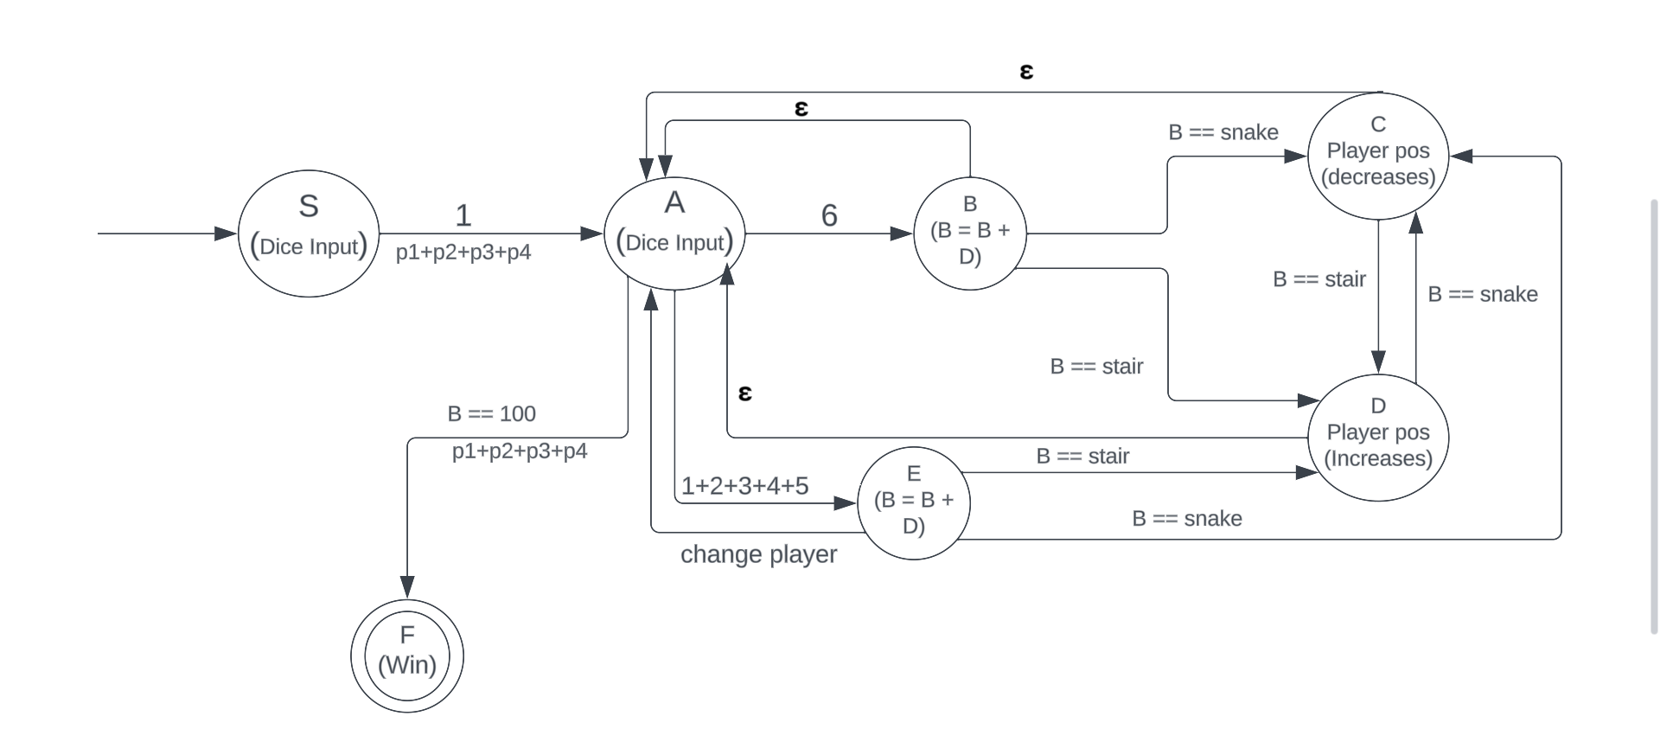
NFA Transition Diagram:

Slide 7
Tech Stack Used:
Java
Java Fx

Slide 8
Limitations
Snakes and Ladders game is relatively simple. Players will roll a die, move their coin, and follow the instructions on the square they land on the board. If the complexity of problem increases, then it may have some dynamic outcomes.
The game's actions are generally limited. Each square on the panel represents a specific state, and transitions between states are straightforward.
Model produced by the Automata are not real-world models. When a real-world model is drawn out will have more issues coming into picture.

Slide 9
Challenges:
Designing the board layout on the panel is one of the challenging part as we have to take correct width and height to place the player coin images, when a dice is rolled.
Implementing the functionality of stairs and snakes as the player should be moved across the board based on the block (snake or stair) he ended up in.
Simulating the rolling of a dice as we need to replace the images according to the users input.

Slide 10
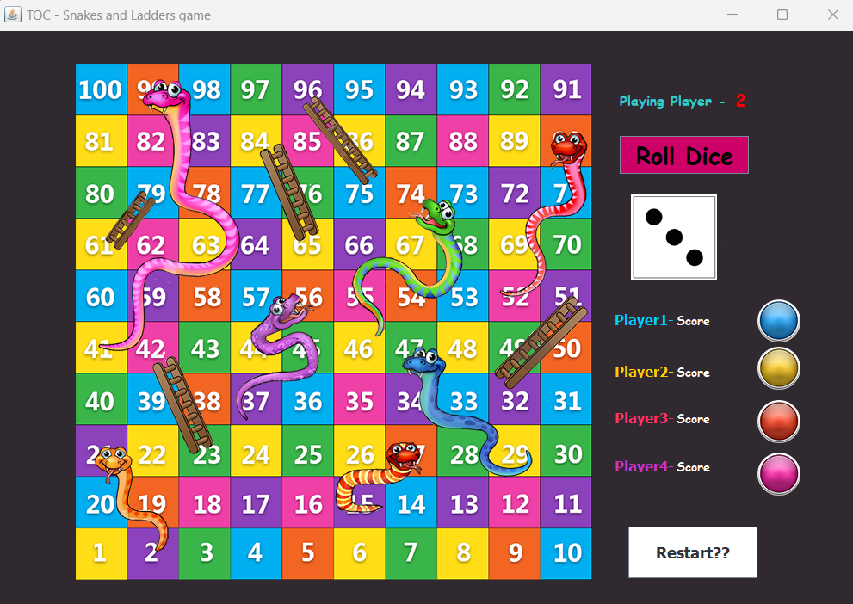
Output:

Slide 11
Conclusion
In conclusion, our snakes and ladders project was a valuable learning experience. We missed few implementations as part of storing the data of players to a database and also had few challenges in designing the game concept.
We gained a solid understanding of how theory of computation works in game designing and how it is built in a programming language like Java.
We had various obstacles during board design layout. We overcame these challenges by going over different textbooks and external resources.
Building a game using java was an effective way to gain hands-on experience in building game.

